Slide 1
Warninternational.com

Slide 2
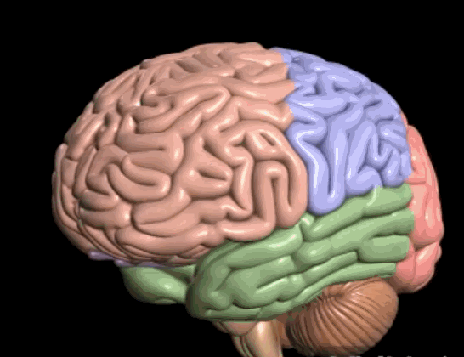

Slide 3
Catastrophising!

Slide 4
CHALLENGING CONVERSATIONS

Slide 5
Guidelines
Think twice, speak once – slow is smooth, smooth is fast
The higher the emotion – the longer your pause, the shorter your reply & the greater the distance away
Try to get the person to THINK –
ask them a question
think about what you just said
think about their behaviour

Slide 6
Managing Emotions

Slide 7
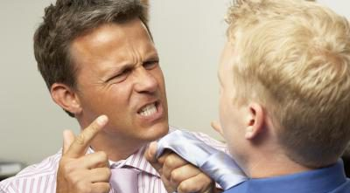
Acknowledging The Emotion Disarms It!

Slide 8
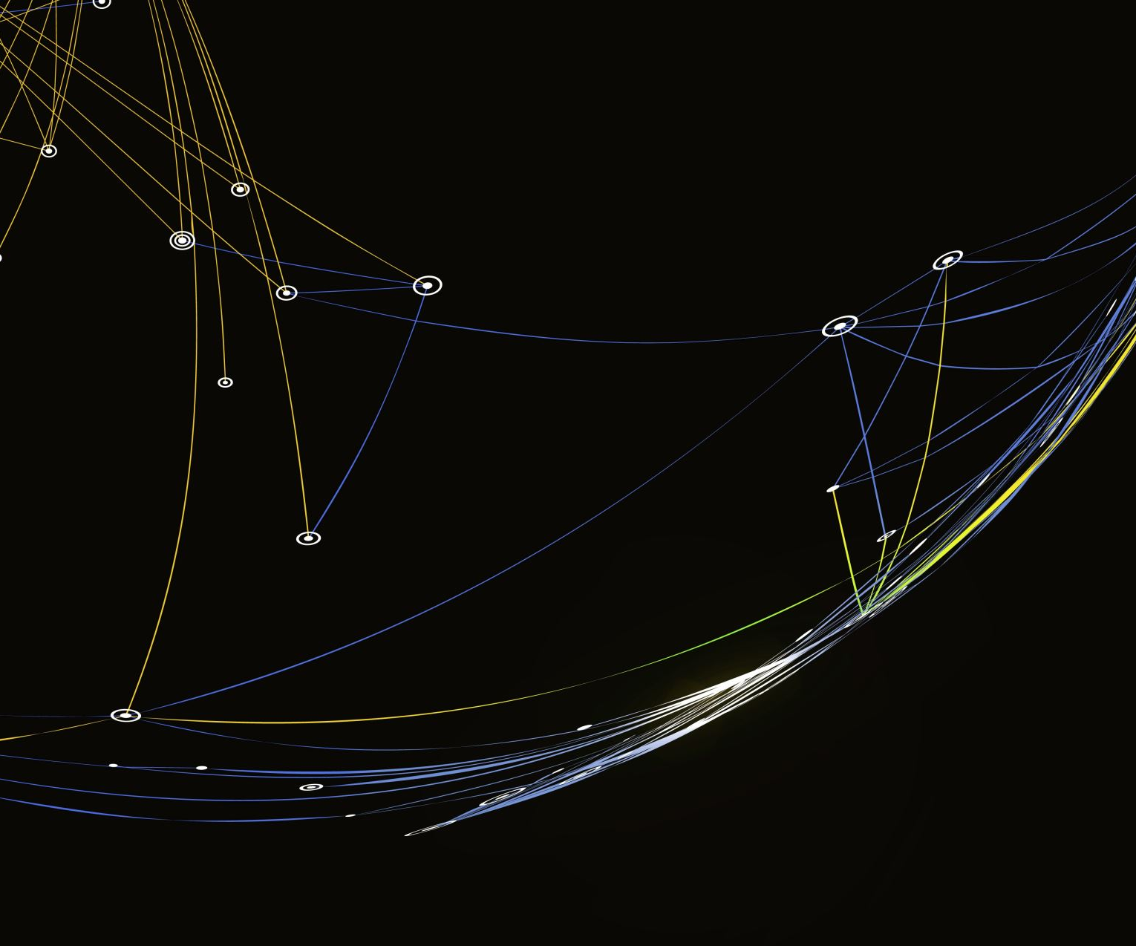
Triple A©
De-escalation

Slide 9
Triple A© - Method
Agree – (make it sound that way) &
Acknowledge – (the situation or emotion) &
Act – (what can you do?)

Slide 10
Triple Sentence©
Delivering a difficult message

Slide 11
Triple Sentence© - Method
What you want to say / this is what happened (Negative)
This is the reason for it / the result (Neutral)
Where to from here / what should they do (Positive)

Slide 12
Triple Direction©
Encouraging better behaviour

Slide 13
Triple Direction© - Method Three Warnings
What they are doing
What is the impact of what they are doing
What do you want them to do

Slide 14
Debriefing Events

Slide 15
Hot, Formal, Psych Debrief
What went well?
What do differently?
What follow-up required?

Slide 16
ADAPTING TO OUR BUSY WORLD

Slide 17
Sleep

Slide 18
Breathe

Slide 19
You’ve Got This!
www.warninternational.com

